Slide 1

Data Clustering Using K-Means Algorithm
for Network Intrusion Detection
Presented by
GROUP-IT-10
111708008 Apurv Upadeo
111708009 Sushant Arbad
111708011 Shridhar Bendare
B.Tech Information Technology
Under the guidance of
Prof. Mr. Deepak Kshirsagar
Department of Computer Engineering and Information Technology
College of Engineering Pune (COEP)
Forerunners in Technical Education
‹#›

Slide 2
Table of Contents
Table of contents
Abstract
Introduction
Literature review
Objectives
Problem statement
System requirement specification
System design
Timeline required for overall Implementation
Publication details if any
References
Department of Computer Engineering and Information Technology
College of Engineering Pune (COEP)
Forerunners in Technical Education
‹#›

Slide 3
Abstract
Network security has become one of today's most urgent social problems. Intrusion detection and prevention is becoming the greatest problem in the field of network security with the rise of hacking and leveraging instruments and the development of new ways of intrusion.
Various techniques are being used in intrusion detections, but sadly all of the systems so far are not fully flawless.
Intrusion detection systems using data mining techniques make it possible to scan patterns and rules in a vast number of audit data. Classification-based data mining models for intrusion detection are often unsuccessful in resolving complex shifts in intrusion patterns and characteristics.
Department of Computer Engineering and Information Technology
College of Engineering Pune (COEP)
Forerunners in Technical Education
‹#›

Slide 4
Abstract
We have used Clustering methods for the identification of network intrusions. We conducted our K-means clustering algorithm experiments and calculated the results based on detection rates and false positive rates with various cluster values.
Using the clustering method, our intrusion detection system is able to detect various types of intrusions while maintaining a low false positive rate
Department of Computer Engineering and Information Technology
College of Engineering Pune (COEP)
Forerunners in Technical Education
‹#›

Slide 5
Introduction
Given the various types of attacks, such as Denial of Service, Spoofing, Session hijacking, Password Guessing, and others, detecting a wide range of attacks is a challenge for any intrusion prevention device.
The purpose of intrusion prevention systems is to detect attacks from the stream of network audit trails automatically.
Due to the ineffectiveness of the signature methods for intrusion detection the approach we have looked forward to is Data Mining and Machine Learning.
An approach which, when the training data set is unlabeled, can identify the records. Unsupervised methods of learning presume that there is no mark for training results. Clustering algorithms have been taken into account as they can in many ways help present intrusion detection and prevention systems.
Department of Computer Engineering and Information Technology
College of Engineering Pune (COEP)
Forerunners in Technical Education
‹#›

Slide 6
Introduction
The effects of clustering can also allow the network security administrator to mark network traffic records as ordinary or intrusive. The amount of network traffic audit data available is typically high , making the process of marking all records very time-consuming and expensive.
Our technique is to create a probabilistic model from the training data and then use it to assess whether or not a new record is an anomaly.
Clustering is an unsupervised process that, by grouping objects into meaningful subclasses, takes a different approach, such that members of the same cluster are very similar and distinct from members of different clusters.
Department of Computer Engineering and Information Technology
College of Engineering Pune (COEP)
Forerunners in Technical Education
‹#›

Slide 7
Introduction
The most important aim of this project is to evaluate the efficiency of the k-means algorithm to develop an intrusion prevention method based on clustering.
Therefore, compare the algorithm output of k-means with different cluster values. In terms of performance parameters, we check the performance of the k-means clustering algorithm as the detection rate and false positive rate and overall accuracy.
The approach based on clustering will outperform and boost the results of intrusion detection in the detection of unseen attacks.
Department of Computer Engineering and Information Technology
College of Engineering Pune (COEP)
Forerunners in Technical Education
‹#›

Slide 8
Literature Review
Intrusion threatens, in terms of availability, honesty and confidentiality, the protection of communication networks. An attacker may be an insider or an outsider attempting to gain unauthorized control and entry of a device.
Intrusion detection systems focused on anomalies presume that all intrusive behaviours are anomalous, which may lead to activities that are anomalous but not intrusive, therefore being mistakenly recorded as intrusive. This is called a false positive.
A clustering technique to detect intrusions from unlabelled data was proposed by Potnoy[1]. They cluster data records that contain both regular behaviours and attacks, using an incremental k-means algorithm, unlike conventional anomaly detection approaches
Department of Computer Engineering and Information Technology
College of Engineering Pune (COEP)
Forerunners in Technical Education
‹#›

Slide 9
Literature Review
A supervised clustering technique was proposed by Ye and Li[2] that creates clusters from labelled training data and uses them to determine the probability of attacking test data instances.
Using the k-mean clustering algorithm, S.Varuna and P.Natesan suggested a hybrid intrusion detection approach to find the distance between each object in the dataset and the number of centroids, using these new characteristics. These new features were then added to the Training and Detection classifier[3].
Guan[4] has defined intrusions with another clustering algorithm, namely an enhanced k-means algorithm that addresses the number of clusters selected and the removal of empty clusters.
Department of Computer Engineering and Information Technology
College of Engineering Pune (COEP)
Forerunners in Technical Education
‹#›

Slide 10
Literature Review
For partitioning a dataset into meaningful patterns, M. Varaprasad Rao[5] used the k-Means clustering algorithm. In the preprocessing and normalisation steps, modified k-Means are applied.
As a result, efficacy is improved and the shortcomings of k Means are overcome. To function on network intrusion data, this approach is proposed and the algorithm is tested with the KDD99 dataset and satisfactory results are found.
Department of Computer Engineering and Information Technology
College of Engineering Pune (COEP)
Forerunners in Technical Education
‹#›
Notes:
HFKJSDFHSKFHSL

Slide 11
Objectives
● To detect the intrusion attacks to prevent systems from various attacks and damages.
● Make a robust and efficient system by experimenting with various techniques.
● To pre-process the raw data and make it suitable for Machine learning by applying techniques in NLP such as lemmatization and stemming and techniques like tf-idf, variance threshold and PCA (Principal Component Analysis).
● To implement k-Means clustering algorithm to detect various intrusion attacks like DOS, U2R, R2L, Probe.
Department of Computer Engineering and Information Technology
College of Engineering Pune (COEP)
Forerunners in Technical Education
‹#›

Slide 12
Objectives
● Normalize clusters based on the statistical information from the training set and find a cluster closest to target using the metric Euclidean distance.
● To detect the accuracy and enhance the efficiency by using various algorithm enhancement techniques.
● Output the model results using the KDD dataset and tabulate the results and evaluate its performance in terms of false positive and false negative rate, recall, precision and overall accuracy.
Department of Computer Engineering and Information Technology
College of Engineering Pune (COEP)
Forerunners in Technical Education
‹#›

Slide 13
Problem Statement
● The aim of the project is to develop a network intrusion detector, a predictive model that can differentiate between "bad" links, called intrusions or attacks, and good or usual connections.
● The amount of network traffic audit data available is typically high , making the process of marking all records very time-consuming and expensive.
● Our technique is to create a probabilistic model from the training data and then use it to assess whether or not a new record is an anomaly.
Department of Computer Engineering and Information Technology
College of Engineering Pune (COEP)
Forerunners in Technical Education
‹#›

Slide 14
Problem Statement
The problem statement can be summarized as-
Evaluation of K-Means Clustering for Effective Intrusion Detection and Prevention in Massive Network Traffic Data
OR
Data Clustering using K-Means Algorithm for Network Intrusion Detection
Department of Computer Engineering and Information Technology
College of Engineering Pune (COEP)
Forerunners in Technical Education
‹#›

Slide 15
System requirement specification
1. Functional Requirements:
● The system should be able to process data using NLP techniques.
● The system should be able to appropriately apply the clustering algorithm and create clusters with the help of models.
● The system should be able to accurately predict and detect intrusion attacks using the clustering approach.
● The system should be able to classify attacks and produce desired results in tabulated format.
Department of Computer Engineering and Information Technology
College of Engineering Pune (COEP)
Forerunners in Technical Education
‹#›

Slide 16
System requirement specification
2. Non-Functional Requirements
2.1 Usability: The system should be highly usable with required accuracy and efficiency.
2.2 Precision: The system should be precise to a degree of detecting the intrusion attacks and the model should be efficient enough to classify the attacks using clustering.
2.3 Performance: The system should take minimum possible time for processing of the data as it needs to process a large number of data or brute force attacks at once thus the system should be as fast as possible so that the user can get the output from the system in a very less amount of time.
Department of Computer Engineering and Information Technology
College of Engineering Pune (COEP)
Forerunners in Technical Education
‹#›

Slide 17
System requirement specification
2.4 Reliability: The system should be reliable and should not fail under specific conditions and also the output data should be secured and should have access to authorised personnel only.
3. Hardware Requirements
• Free Memory on HDD: At-least 2 GB
• Memory: 2 GB • Processor: 2.5+ GHz processor or higher
4. Software Requirements: • Operating System: Windows 8 or higher version of Windows / Ubuntu 18.04 or higher • Programming Environment: Python 3
Department of Computer Engineering and Information Technology
College of Engineering Pune (COEP)
Forerunners in Technical Education
‹#›

Slide 18
System requirement specification
5. Developer Tools:
• Python3 IDE like Visual Studio or PyCharm or Jupyter Notebook
• NLTK (Natural Language Toolkit)
• Deep learning libraries and Scikit Learn libraries
• NumPy • SciPy • Pandas • TensorFlow • Matplotlib
Department of Computer Engineering and Information Technology
College of Engineering Pune (COEP)
Forerunners in Technical Education
‹#›

Slide 19
System Design
K- Means Clustering :
The data objects within a cluster are identical and the data objects belonging to two different clusters are not similar.
Initially, k objects are randomly chosen as cluster centres, where k is the number of clusters and reassigns each object to a cluster, depending on the mean value of the objects. It repeats this process until no shift occurs.
Department of Computer Engineering and Information Technology
College of Engineering Pune (COEP)
Forerunners in Technical Education
‹#›

Slide 20
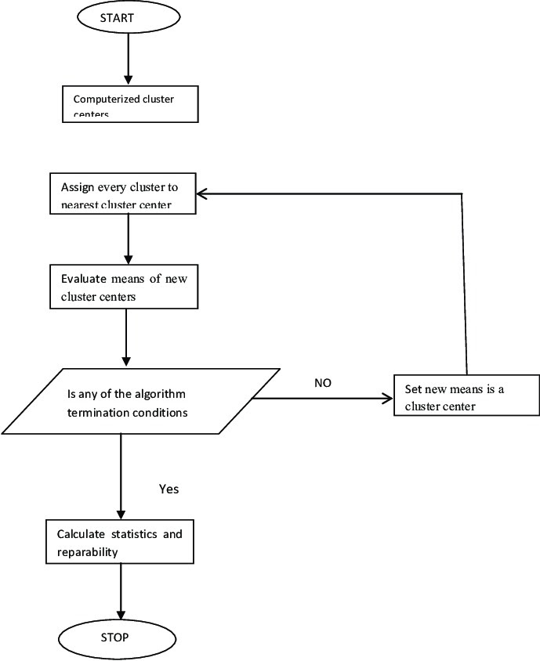
System Design
Department of Computer Engineering and Information Technology
College of Engineering Pune (COEP)
Forerunners in Technical Education
‹#›

Slide 21
System Design
Two methods in combination are used to find the optimal number of clusters.
1. Elbow Method
It is one of the popular methods to determine the optimal value of ‘K’.
2. Silhouette index
The silhouette value is a measure of how similar an object is to its own cluster (cohesion) compared to other clusters (separation).
Department of Computer Engineering and Information Technology
College of Engineering Pune (COEP)
Forerunners in Technical Education
‹#›

Slide 22
System Design
PCA - Principal Component Analysis:
Principal Component Analysis, or PCA, is a dimensionality-reduction method that is often used to reduce the dimensionality of large data sets by transforming a large set of variables into a smaller one that still contains most of the information in the large set.
So, the idea of PCA is simple — Reduce the number of variables of a data set, while preserving as much information as possible.
Department of Computer Engineering and Information Technology
College of Engineering Pune (COEP)
Forerunners in Technical Education
‹#›

Slide 23
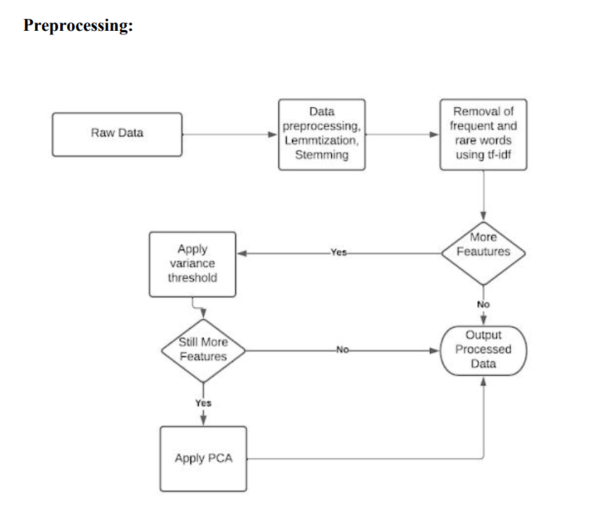
System Design
Department of Computer Engineering and Information Technology
College of Engineering Pune (COEP)
Forerunners in Technical Education
‹#›

Slide 24
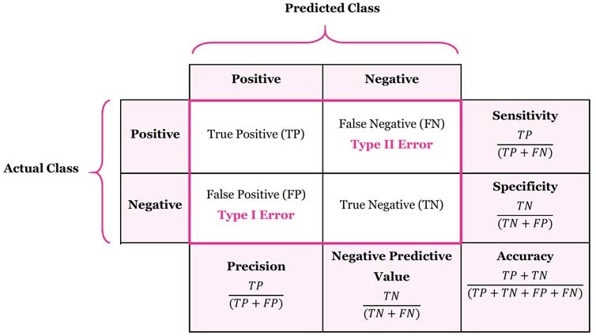
System Design
Performance Metrics: In order to check performance, the various metrics used are given as follows:
1. Detection Rate (DR)
2. False Alarm Rate (FAR)
3. False Positive (FP)
4. False Negative (FN)
5. True Positive (TP)
6. True Negative (TN)
Department of Computer Engineering and Information Technology
College of Engineering Pune (COEP)
Forerunners in Technical Education
‹#›

Slide 25
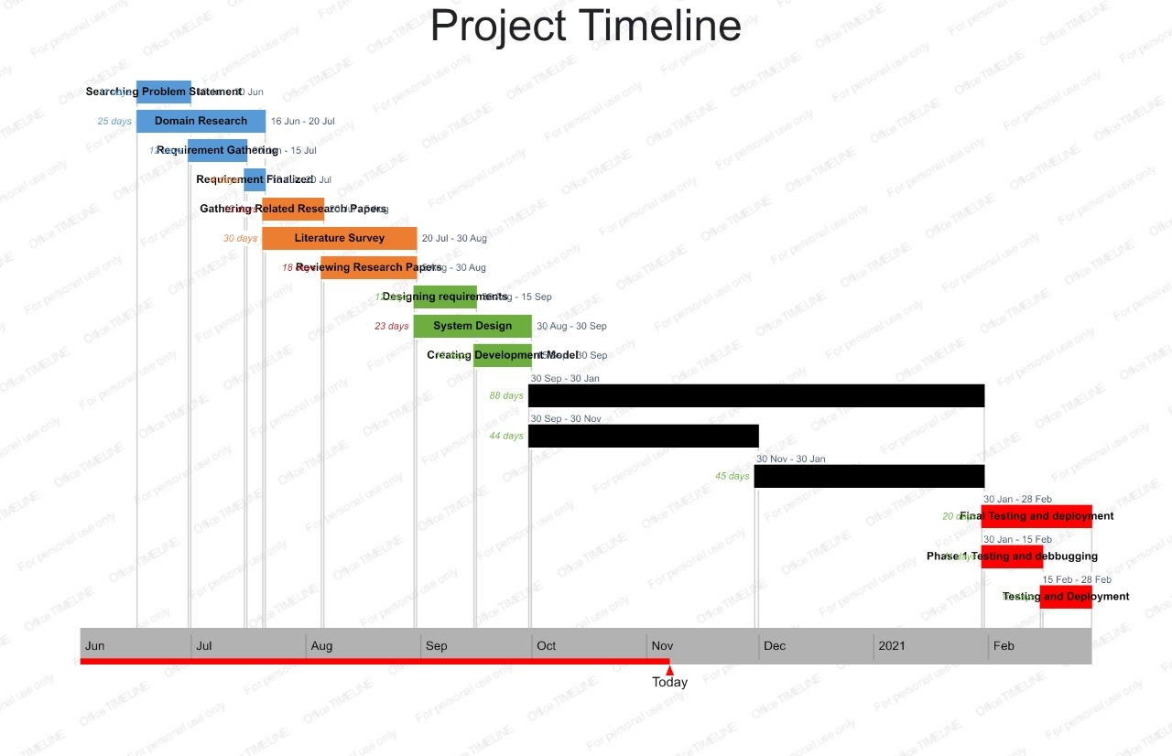
Department of Computer Engineering and Information Technology
College of Engineering Pune (COEP)
Forerunners in Technical Education
‹#›

Slide 26
References
[1] L. Portnoy, E. Eskin and S. Stolfo, Intrusion detection with unlabeled data using clustering, in ACM Workshop on Data Mining Applied to Security (Philadelphia, PA) (2001).
[2] N. Ye and X. Li, A scalable clustering technique for intrusion signature recognition, in Proc. 2nd IEEE SMC Information Assurance Workshop (2001), pp. 1–4
[3]S.Varuna, Dr.P.Natesan, ―An Integration of K-Means Clustering and Naïve Bayes Classifier for Intrusion Detection‖, 3rd International Conference on Signal Processing, Communication and Networking (ICSCN), 2015.
Department of Computer Engineering and Information Technology
College of Engineering Pune (COEP)
Forerunners in Technical Education
‹#›

Slide 27
References
[4] Y. Guan, A. A. Ghorbani and N. Belacel, Y-means: A clustering method for intrusion detection, in Canadian Conference on Electrical and Computer Engineering, Montral, Qubec, Canada (2003), pp. 1–4.
[5]M.Varaprsad Rao “Algorithm for Clustering with Intrusion Detection Using Modified and Hashed K – Means Algorithms “Published by IEEE Computer Society,2012
Department of Computer Engineering and Information Technology
College of Engineering Pune (COEP)
Forerunners in Technical Education
‹#›

